Slide 1

Government College of Engineering, Karad (An Autonomous Institute of Government of Maharashtra) Department of Information Technology
Final Year B.Tech. [Summer-2025]
Project IT2808
Title: Projects made using the Frontend Technology.
Company Name: Tech Prescient
Name of Guide: | Mentors | Student Name [Reg.No.]
Prof. S. J. Wagh | Kalpesh Shirudkar Abhilash Bharamappa | Aishwarya Viraj Tembe. (id 4)

Slide 2
Tools and Technologies learnt:
Technologies (Core Concepts & Languages)
HTML, CSS, Javascript
TypeScript – Typed superset of JavaScript for better maintainability
Libraries & Frameworks
React – Frontend framework for building UI components
Redux , Context API – State management solution
Gatsby JS: A static site generator built on top of react.
GitHub: for version control

Slide 3
Tools & UI Frameworks
Material UI (MUI) – Pre-designed React UI components for better design consistency
Tailwind CSS- CSS framework with utility first approach.
i18next (i18n) – Internationalization library for multi-language support
Visual Studio Code- An IDE to implement code.

Slide 4
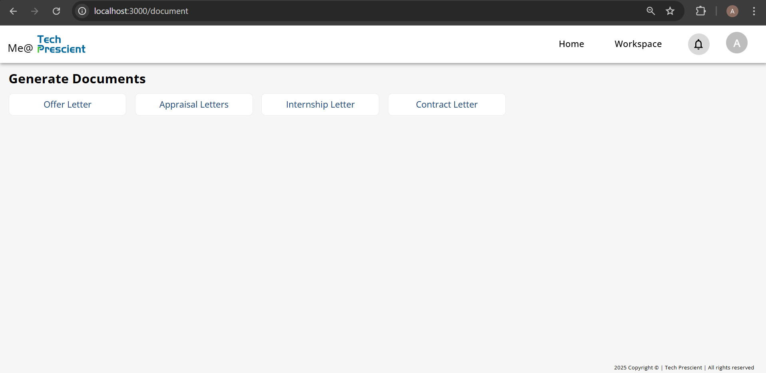
Trainings Taken and Concept Implementation
1. MIS project:

Slide 5
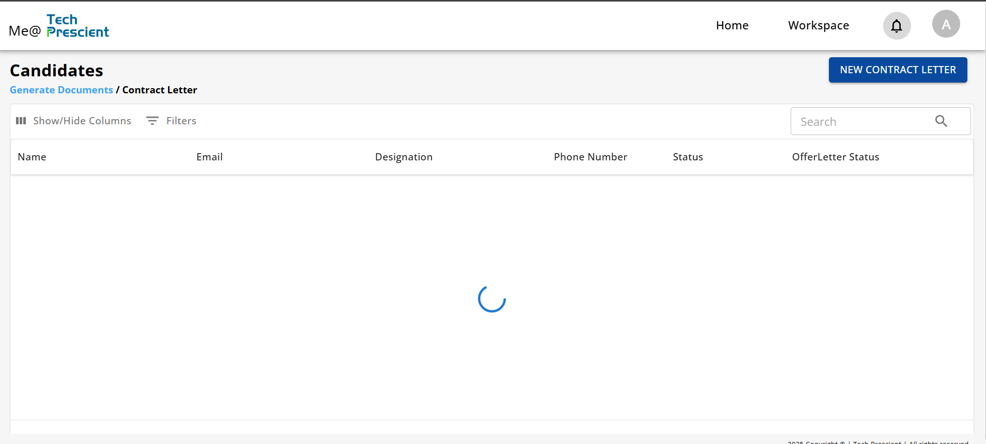

Slide 6
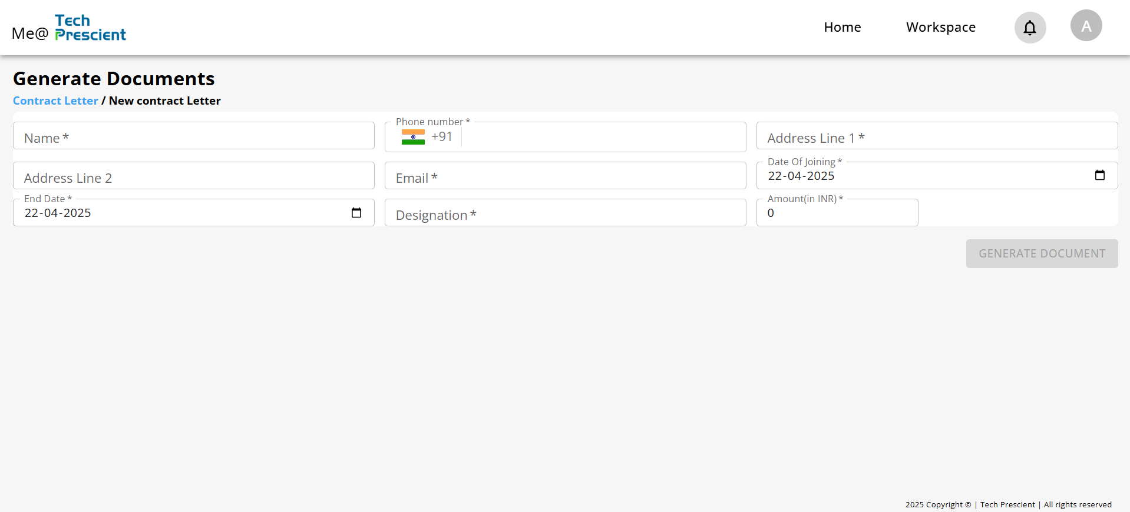

Slide 7
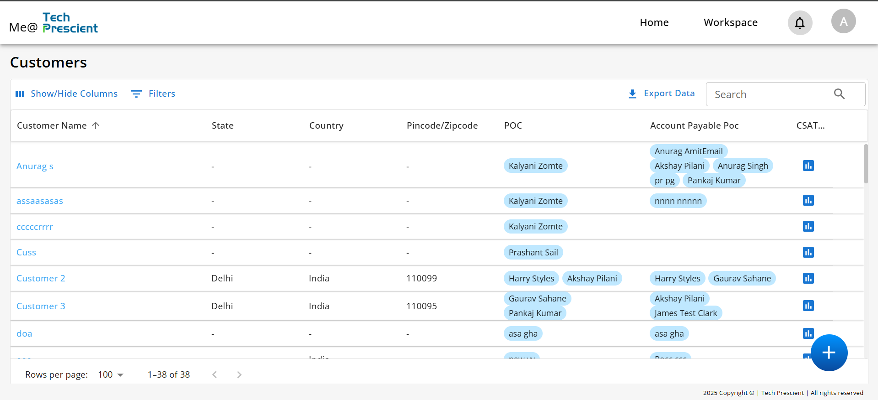
2. CSAT:

Slide 8
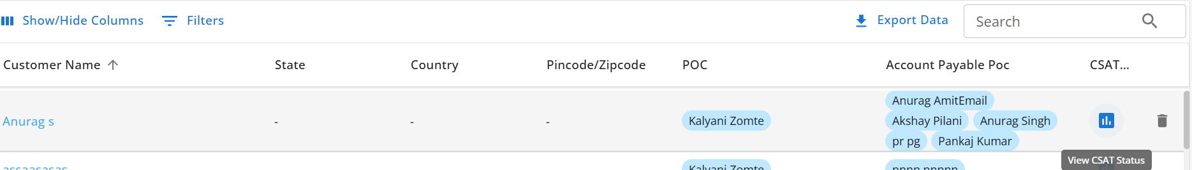
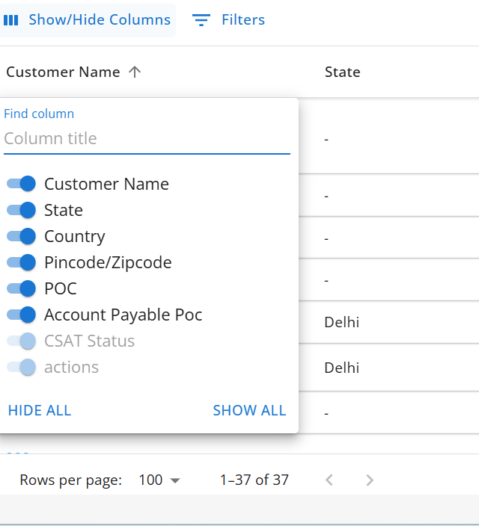
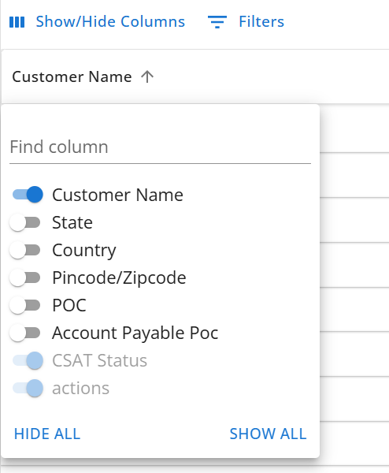
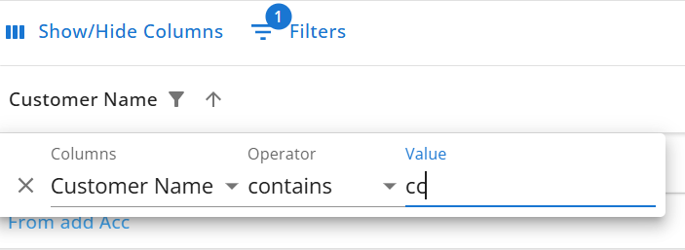

Slide 9
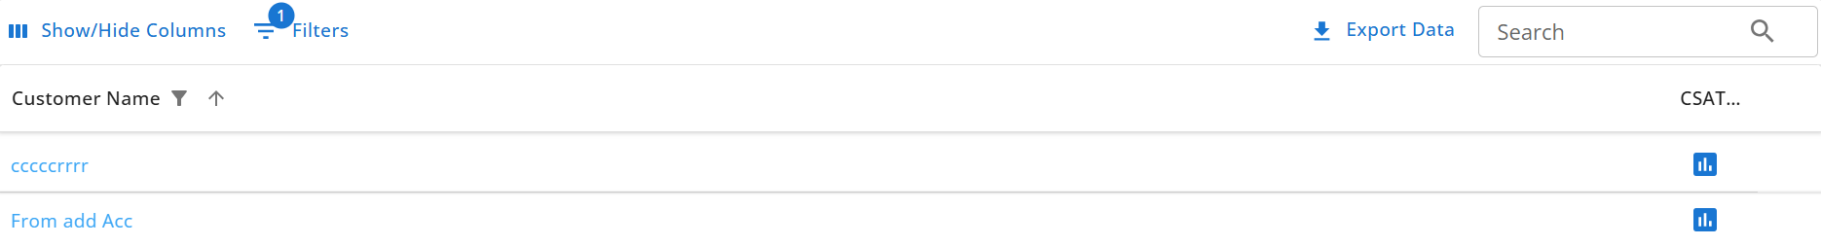
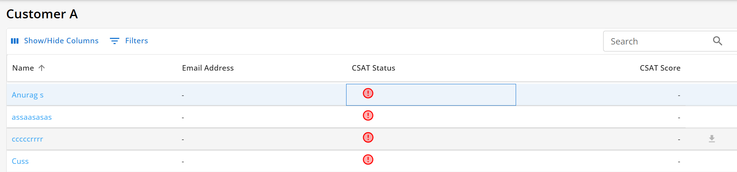
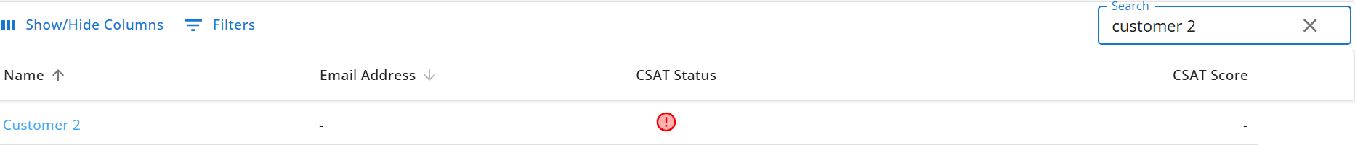

Slide 10
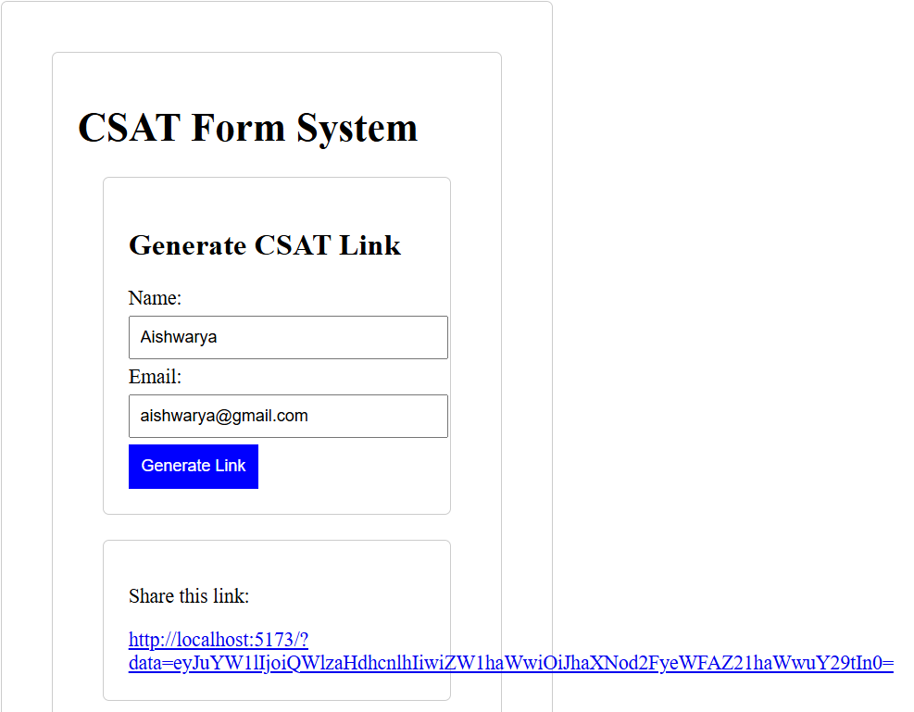
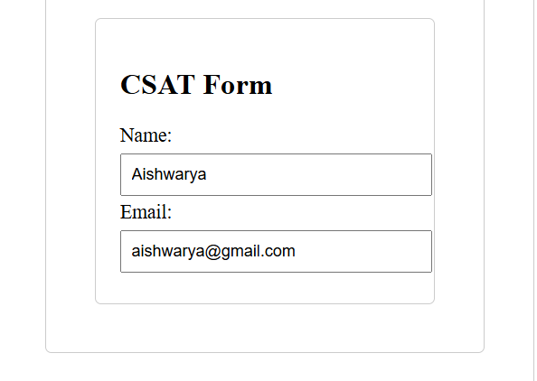
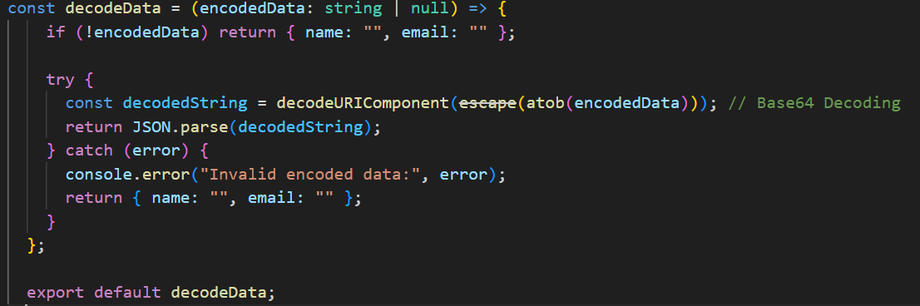
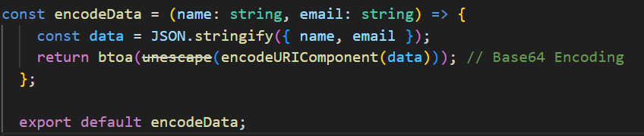
CSAT encryption and decryption

Slide 11
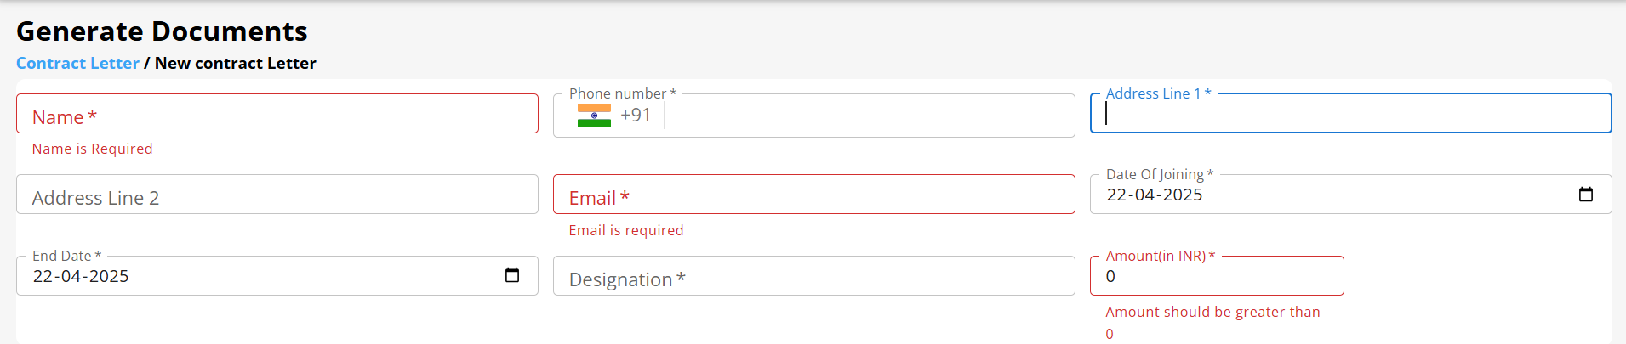
Features:
Added validation and according to effects.
For phone number, the keys other than number are disabled.
Breadcrumb Navigation: Breadcrumbs are a hierarchical navigation aid that show users their current location in a website or app structure and allow easy movement back to parent pages.
API integration

Slide 12
3. Company’s website:

Slide 13
Outcomes
Stronger Frontend Development Skills – Gained expertise in React, state management, and component-based architecture.
Improved Code Quality – TypeScript has helped in writing error-free, maintainable code
Better UI Development – Learned how to use Material UI to enhance the user experience.
Localization Experience – Implemented multi-language support using i18n Problem-Solving Ability – Improved debugging and troubleshooting skills. 🌟 Time Management – Effectively handled deadlines and structured project tasks. 🌟 Team Collaboration – Worked efficiently in a team environment and followed best practices.

Slide 14
Outcomes
Handle large amount of codebase.
Learn through similar features and try to recreate those with modifications.
Worked on real-world web applications and followed modern development standards
Gained hands-on experience with Git, React, Tailwind, Gatsby, and more

Slide 15
Feedback

Slide 16
Thank You

